Slide 1


&

Slide 2

Agenda
Critical Business Issues/Discussion
ROI: How we can help!
Pricing

Slide 3
Pain Points
Need to increase internal promotion of and use of Linkedin Learning
Potential expansion of eLearning program to the IT Department
What else?
Notes:
Open ended questions:
As a director, how does your team learn?
What challenges are you facing?
How engaged do you feel you team is? Could you make it better and if so how?
How could any employees working offsite who could benefit from instant access to education?
Company ABC (PC Construction) has faced challenges with an inundation of IT questions unrelated to the specific skill set of their technical team. How do you think the knowledge skillset of your team could be improved? Do you think that educating other departments would help focus the types of questions presented to your IT department?

Slide 4
IT Industry Facts
IT workers get 32 recruiter emails per week on average
#1 reason IT professionals leave their job is lack of career growth
2/3 of millenials believe it is their managers job to provide development opportunities
According to an annual Gallup poll only 30% of the American Workforce is Engaged at work (70% are not engaged or actively disengaged)
Notes:
- LinkedIn has the educational program YES but is also has the employment data analytics to help you back educating your workforce strategically
- There is a war for talent!
- My good friend quit her IT job of 9 years 4 months ago because she felt that she was expendable – Imagine all the knowledge you will lose

Slide 5
LinkedIn Solution
Provide clear paths for career growth via education
Helps create a meaningful workplace
Create a culture of advancement from within
This will help you become a better manger
Notes:
How do you prevent an IT employee from leaving? Give them a sense that there is advancement beyond their existing role.
One of the top reasons employees quit is a negative relationship with their managers

Slide 6
ROI and Success!
How can we help?
Decrease cost to company
Increase time spent onsite as opposed to offsite for training (AutoCad & Revit)
More bandwidth for your IT teams when eLearning is leveraged over IT tickets
Happier and more engaged employees (less attrition!)

Slide 7
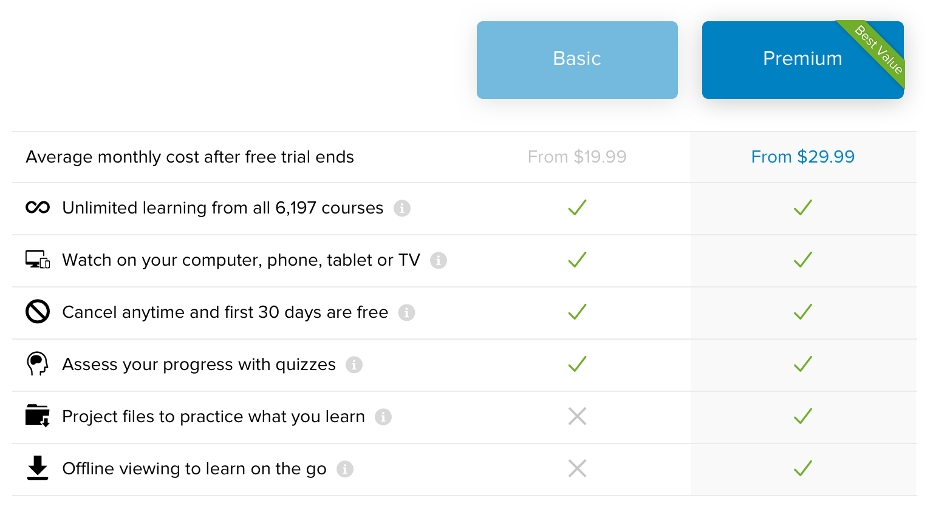
Your Investment!

